Slide 1

HIRING PROCESS ANALYTICS

Slide 2

PROJECT DESCRIPTION
The hiring process is a crucial function of any company, and understanding trends such as the number of rejections, interviews, job types, and vacancies can provide valuable insights for the hiring department. The company's hiring process data is been analysed to draw meaningful insights from it.

Slide 3
APPROACH
The data cleaning and analysis is done by:
  Handling Missing Data: Column event_name had missing values or null values. Those are replaced with “Don’t want to say” as they both implies same in this project i.e. gender of candidate is not known.
  Column Offered Salary had 1 row with Null value. The corresponding value in Department column is “Sales Department” and Post Name is i7.So it is replaced with median of offered salary for sales department and i7 Post Name. The median came out to be 49625.
  Error Detection: There is a Post Name c-10 which might be an typo error and it can be corrected as c10.
  After cleaning and preparing the data. This tasks are performed by calculating averages, medians, and other statistical measures. The visualizations are created to better understand the data.

Slide 4


Microsoft Office 2019 is used
MS Excel is used to enter data in table format, perform computations, plot graphs etc. Here it is used to filter data and clean the data to get insights for hiring process.
TECH-STACK USED
Microsoft PowerPoint 2019
It is used for documenting the insights and give presentation of the analysis done to the hiring teams to make better decisions.

Slide 5
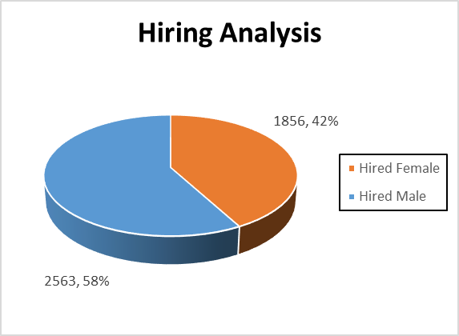
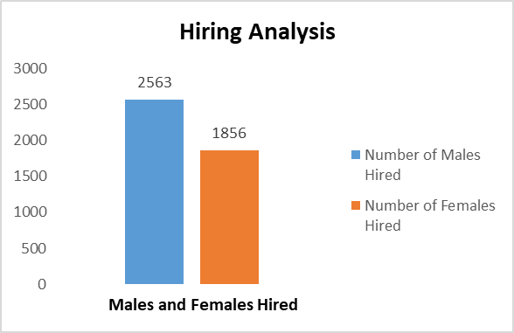
Data Analytics Tasks
Hiring Analysis: The hiring process involves bringing new individuals into the organization for various roles.
Task:Determine the gender distribution of hires. How many males and females have been hired by the company?
Result:
There are 58% of Male i.e. 2563 and 42% of Females i.e. 1856 hired by the company.

Slide 6
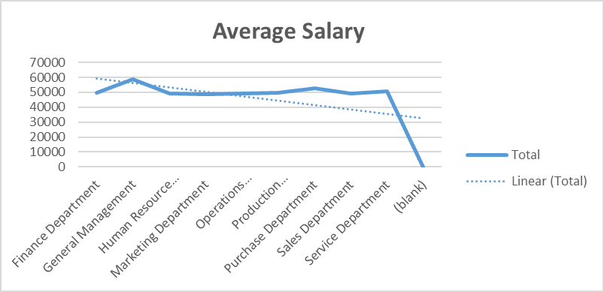
Salary Analysis:
The average salary is calculated by adding up the salaries of a group of employees and then dividing the total by the number of employees.
Task: What is the average salary offered by this company? Use Excel functions to calculate this.
Result:
  Average Salary of Employees 49983.03056
  Function Used:
=AVERAGE(SUMIFS(Sheet1!G:G,Sheet1!C:C,"Hired")/COUNTIF(Sheet1!C:C,"Hired"))
  Below graph shows the average salaries of all departments are same for all candidates .It shows that the hiring team is recruiting candidates as per the pre defined salary bands of the organization.
Departments | Average of Offered Salary
Finance Department | 49628.00694
General Management | 58722.09302
Human Resource Department | 49002.27835
Marketing Department | 48489.93538
Operations Department | 49151.35438
Production Department | 49448.48421
Purchase Department | 52564.77477
Sales Department | 49311.29593
Service Department | 50629.88418
(blank)
Grand Total | 49983.03056

Slide 7
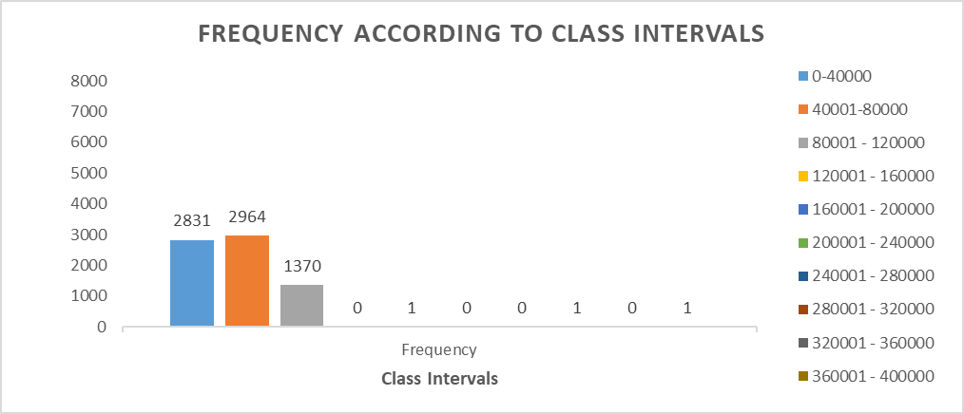
Salary Distribution:
  Class intervals represent ranges of values, in this case, salary ranges. The class interval is the difference between the upper and lower limits of a class.
Task: Create class intervals for the salaries in the company. This will help you understand the salary distribution.
Result:
  From the below graph we observe that the maximum salary offered are in intervals of 40001-80000 and minimum salary offered are in intervals 120001 – 400000.

Slide 8
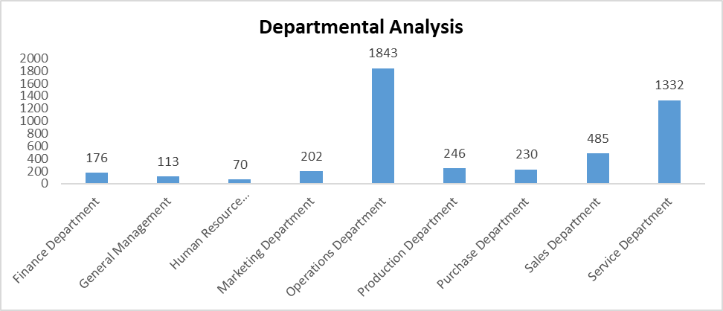
Departmental Analysis :
  Visualizing data through charts and plots is a crucial part of data analysis.
Task: Use a pie chart, bar graph, or any other suitable visualization to show the proportion of people working in different departments.
Result: The below graph shows the number of people working in each department. Maximum number of people are hired for Operations Department and Service Department.
Proportion of people working in different deptartments | Number of People
Finance Department | 176
General Management | 113
Human Resource Department | 70
Marketing Department | 202
Operations Department | 1843
Production Department | 246
Purchase Department | 230
Sales Department | 485
Service Department | 1332

Slide 9
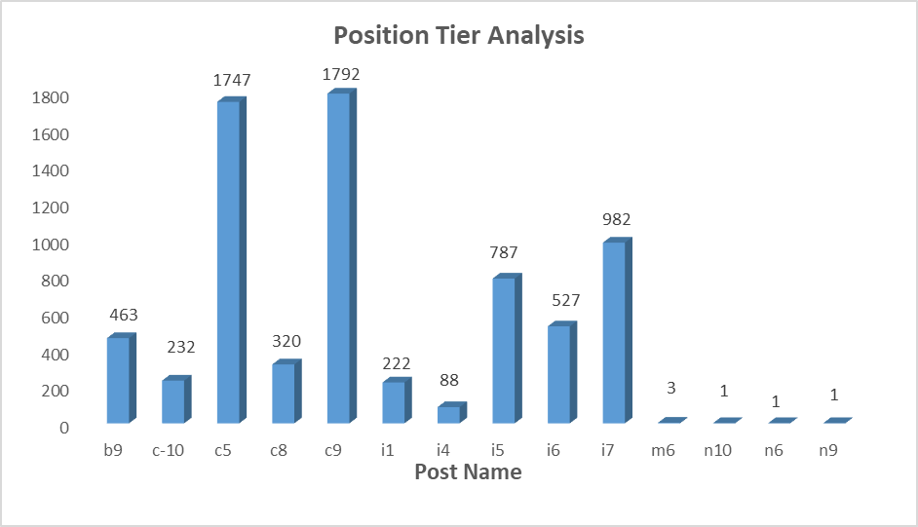
Position Tier Analysis:
  Different positions within a company often have different tiers or levels.
Task: Use a chart or graph to represent the different position tiers within the company. This will help you understand the distribution of positions across different tiers.
Result: From the below graph we observe that most of the hiring is done for C9 and C5 post followed by i7 and i5.
Proportion of different post tiers | Number of post tiers
b9 | 463
c-10 | 232
c5 | 1747
c8 | 320
c9 | 1792
i1 | 222
i4 | 88
i5 | 787
i6 | 527
i7 | 982
m6 | 3
n10 | 1
n6 | 1
n9 | 1

Slide 10
Insights:
High gender ratio can negatively impact the company image in public domain. There are 58% of Male and 42% of Females hired by the company. Company should focus to maintain the gender ration close to 1.
The Quality team should ensure that the data is complete and relevant. The incomplete and irrelevant information can given the wrong analysis results.
Maximum number of people are hired for Operations Department and Service Department. The hiring teams can focus on more openings for those department.
Conclusion:
The insights could potentially help the company to improve its hiring process and make better hiring decisions in the future.

Slide 11
Drive Link:
https://drive.google.com/drive/folders/14dixBmt2-qM24qdBNZIh1D0wV-dSN52m?usp=drive_link
EXCEL FILE link:

Slide 12
THANK YOU

